Slide 1
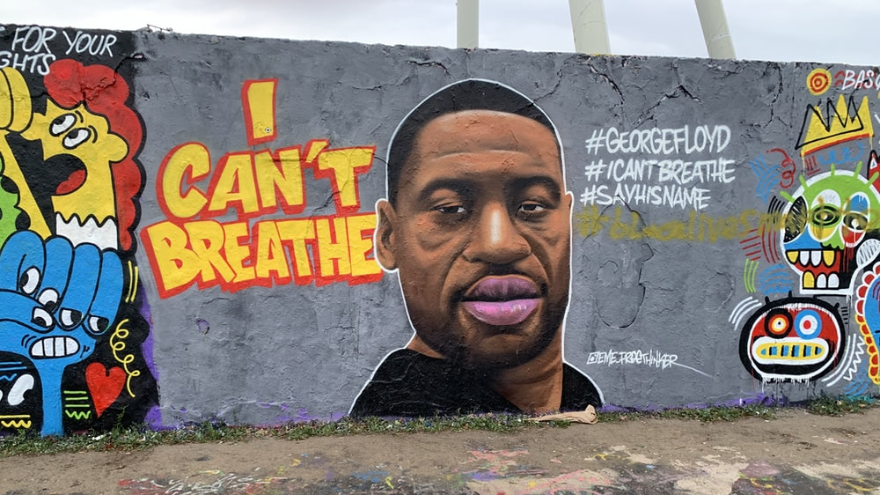
The pain and the outrage
Lyrics: John Campbell
Tune: To God be the glory
Image: James Allan/Unsplash

Slide 2
The pain and the outrage are strong, fresh and true: once more, in broad daylight, injustice showed through.

Slide 3
Once more, law enforcement was so far from fair: it shrieked the deep secrets of wrongs always there.

Slide 4
So our song – cries of wrong that we all have to right, ev’ry day, come what may, let’s stay true to this fight,

Slide 5
to rebuild our world in response to God’s call, till freedom and justice are lived out for all.

Slide 6
America knows its original sins – the evil of slav’ry, the mindset it brings;

Slide 7
though slav’ry itself was dislodged long ago, its poisons still poison the world that we know.

Slide 8
So our song – cries of wrong that we all have to right, ev’ry day, come what may, let’s stay true to this fight,

Slide 9
to rebuild our world in response to God’s call, till freedom and justice are lived out for all.

Slide 10
In Britain we cannot just stand back and stare, our own story’s left us deep evils we share;

Slide 11
through Windrush, through Empire, slave-thinking stayed strong; let’s pledge to the struggle to root out this wrong.

Slide 12
So our song – cries of wrong that we all have to right, ev’ry day, come what may, let’s stay true to this fight,

Slide 13
to rebuild our world in response to God’s call, till freedom and justice are lived out for all.

Slide 14
For black people killed or life-blighted or used, let’s pray, but let’s work to end all this abuse.

Slide 15
We all are diminished whilst some are denied the freedom, the justice for which our hearts cried.

Slide 16
So our song – cries of wrong that we all have to right, ev’ry day, come what may, let’s stay true to this fight,

Slide 17
to rebuild our world in response to God’s call, till freedom and justice are lived out for all.

Slide 18
For George Floyd. A first response to the shocking news of this public death. – John Campbell, 31 May 2020

