Slide 2
God’s Family – all are welcome
Name of church
Date of service

Slide 3
Welcome
To worship God
To sing God’s praises
To encourage one another as we seek to live life as followers of Jesus
“It’s great to be here with you today!”

Slide 4
Songs x2
Blessing and Honour (Jamie Harvill & Gary Sadler)
10, 9, 8 God is Great (Colin Buchanan)

Slide 5
Call to Worship
Let us worship God! Jesus said that whoever welcomes one of his followers, welcomes Jesus himself.
All are welcome here! Let us worship God.
Welcome a person near you and ask them “What is your favourite type of drink?”

Slide 6
Call to Worship
Whoever welcomes Jesus, also welcomes God.
All are welcome here! Let us worship God.
Welcome someone you haven’t met before or someone who is at least 20 years different in age to yourself.
Ask them:
“Who do you enjoy sharing a meal with?”

Slide 7
Call to Worship
Whoever offers even a cup of cold water to one of God’s children will be blessed by God.
All are welcome here! Let us worship God.

Slide 8
Song
You are Welcome (Snack Music)

Slide 9
Intergenerational ministry is about building and deepening relationships across generations so that we all grow as disciples of Jesus.

Slide 10
An intentionally intergenerational environment is more likely to encourage and sustain lifelong discipleship for all ages.

Slide 11
Being intergenerational is…
Not just about children, it’s about people of all ages
Not about what we do, it’s about who we are
Not something that just happens, it requires intentionality

Slide 12
The key is developing and deepening
intergenerational connections

Slide 13
What do you like about church?
Why do you attend church?
Who do you like to see or catch up with at church?

Slide 14
Prayers of Praise and Thanksgiving

Slide 15
The key is developing and deepening
intergenerational connections

Slide 16
Intergenerationality is for the whole church
A core value
An attitude/disposition
Encompasses all aspects of our life together

Slide 17
Intergenerationality is for the whole church
Caring
Praying
Learning
Celebrating
Serving
Ref. Generations Together by John Roberto

Slide 18
An intergenerational worship service would be planned in a way that:
Connects people across the generations
Invites participation through a variety of abilities
Engages some of our five different senses
Engages some of the different ways that people learn (refer different learning theories)

Slide 19
Being intergenerational is an attitude that we bring to worship rather than something we program in.
Leaders have responsibility for modelling, curating and celebrating worship that is truly intergenerational.

Slide 20
In our current worship contexts, to what extent…
• are multiple ages being engaged together?
• are new relationships being created & developed?
• is there diverse, embracing and collaborative leadership?
• is the environment conducive to a variety of gifts, needs and learning styles?
(Ref “Best Practices in Intergenerational Faith Formation” by John Roberto in the Fall/Winter 2007 edition of Lifelong Faith)

Slide 21
In pairs
What have you enjoyed about these ideas?
What have you found challenging/confronting?
What questions would you like to ask?

Slide 22
The hope of intergenerational worship is that people are being encouraged to worship God.

Slide 23
Offering, Song and Notices
Take My Life and Let It Be (Frances Havergal)

Slide 24
God’s Family – all are welcome

Slide 25
What Bible stories can you think of that include people of all ages?

Slide 29
Prayer of confession
Find someone of a different age to you and ask if you can sit or stand next to them.

Slide 30
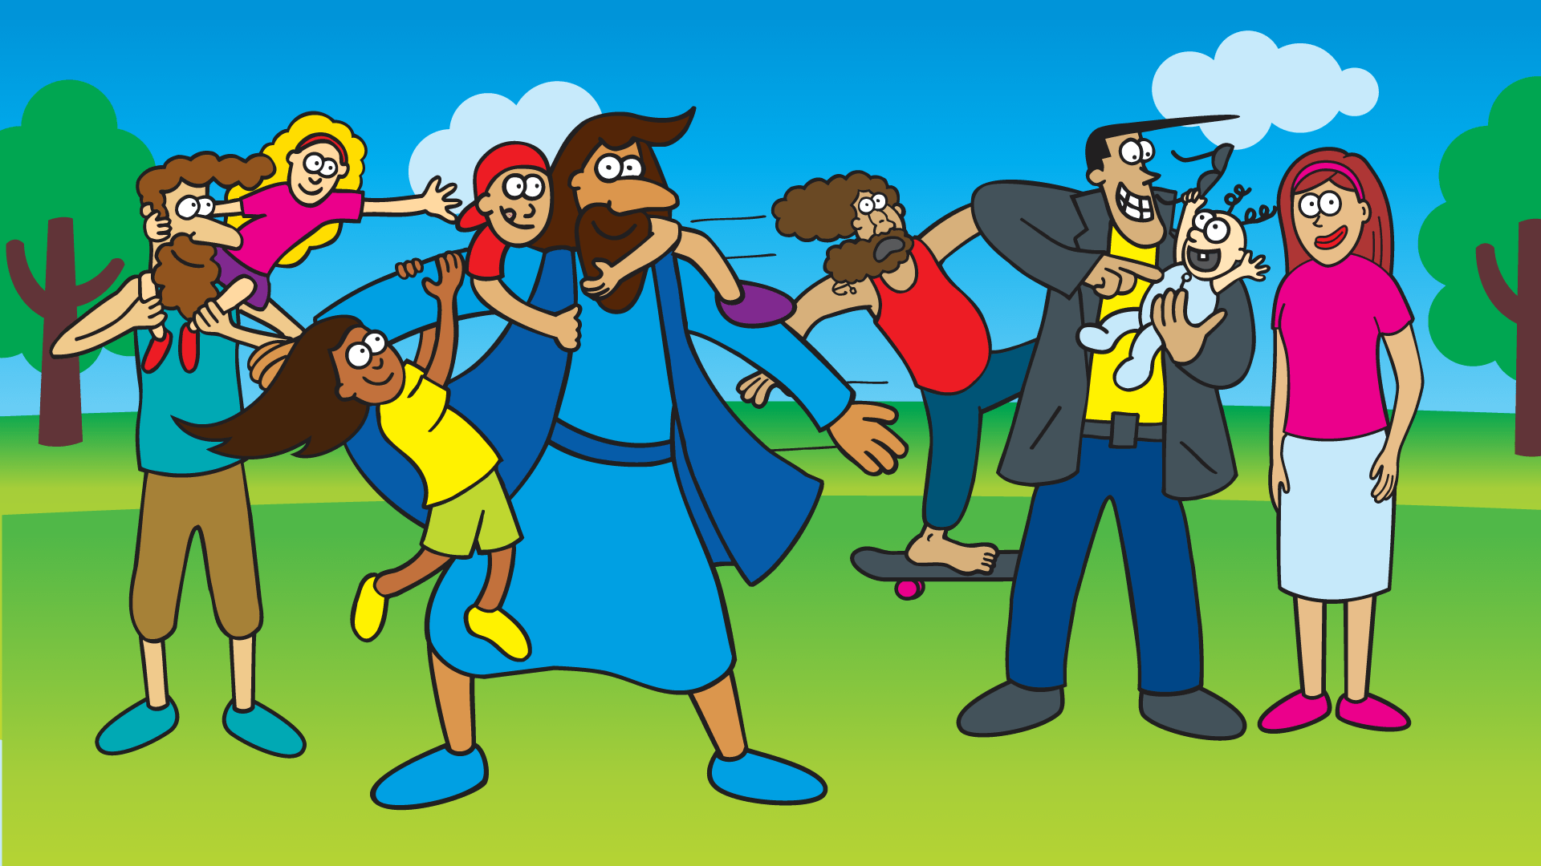
© 2016 Lost Sheep Resources Pty Ltd.
Notes:
God’s kingdom is for the kids!

Slide 31
Song
Life is better with a little mess (Heather Price)

Slide 32
Prayers for others
What is your prayer for someone who is a different generation to you?

Slide 33
Song
10, 000 Reasons (Jonas Rymin, Matt Redman)

Slide 34
© 2016 Lost Sheep Resources Pty Ltd.
Notes:
God’s kingdom is for the kids!

